Slide 1


[your company logo]
Why [company name]
Should Make the Switch to an ICHRA
Better Health Benefits & Cost Savings for Our Business & Employees

Slide 2
[company logo] Current Pain Points With Traditional Group Insurance
Employee Satisfaction
Benefits Quality
High Cost
Administrative Burden
expensive (especially employees with families)
no flexibility/control - plans don’t cover specific health/Rx needs
insufficient coverage
limited options
lack of transparency
few doctors/facilities in-network
difficult for out-of-state employees
premiums rise every year (6-12%)
plans are expensive and don’t meet employee needs
40% of time is spent on benefits administration
compliance
negotiating with carriers
recruitment/retention
of employees with families pay an additional $13,872 (average) compared to those with single coverage
of businesses offer just 1-3 health plans
is the average rise of yearly premiums
of people said that quality insurance was a deciding factor in whether they stayed at a job
185%
75%
12%
56%
*mid-market and large sized groups are most likely to have "unsatisfied employees" due to coverage and/or cost
*these prices increase every year and are predicted to increase even higher in 2023
*that’s 185% more than single individuals
Resources: KFF Health News
HR dive

Slide 3
The Solution|
The Individual Coverage Health Reimbursement Arrangement (ICHRA)
ICHRA Benefits
The Individual Coverage Health Reimbursement Arrangement (ICHRA) is a type of employer-provided health benefit plan that allows employees to choose their own health insurance coverage from the individual market and receive reimbursement from their employer for a portion of the premiums.
12% savings on yearly premiums with an ICHRA in 2022
40% of time saved on administration hassles
Predictable cost & price transparency
Offered pre-tax through payroll
  Integrated via HRIS systems
More choice without the administration/hassle
Employee plan ownership (goodbye COBRA)
Significant premium decreases
Employees choose a plan that fits their needs/budget - better retention and recruitment
All plans are fully insured & ACA compliant
  easy coverage for all out-of-state employees
Since 2020,
17.5 million employees have been enrolled in individual plans
By 2025, over 8 million employers will offer ICHRAs & 11million previously uninsured workers will now opt into employer coverage
Resources: Milliman, Stratus HR, DOL.gov

Slide 4
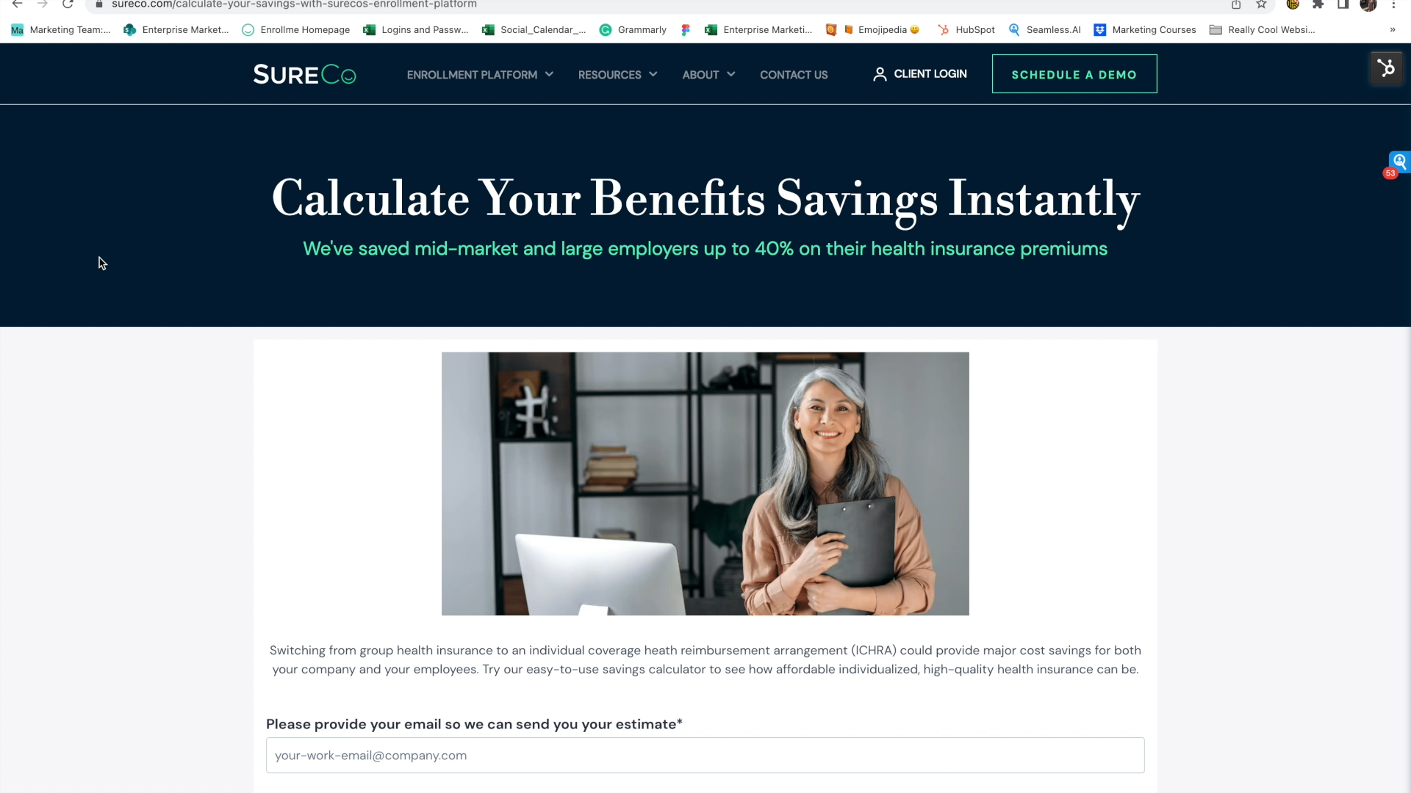
Calculator Tutorial (delete page when ready to present)

Slide 5
Input Calculations From Here
See instructions from the previous slide
& delete this box when presenting
[company logo] ICHRA Implementation + Potential Savings
SureCo’s Enrollment Platform
Our Cost Savings Analysis
Current number of eligible employees:
Number of out-of-state employees:
Broker friendly
Turnkey solution
Price transparency
Decreased yearly premiums
Tax advantage
HRIS integration
Simplified ACA & COBRA compliance
More choice, greater customization
Administration relief
Current Costs
Savings With SureCo
Monthly Savings - Employees
–
Annual Savings - Employees
–
Monthly Costs - Employer
Annual Costs - Employer

Slide 6

SureCo's Enrollment Platform Case Study | KR Management
KR Managment Before SureCo
Heavy benefits administration
Got hit with 25% premium increase in 2022
Loss ratio around 170% - 200%
35% savings on yearly premiums
KR Managment with SureCo
35% savings on yearly premiums ($350,000+)
950 eligible employees
Quick implementation (under 21 days)
Payroll reductions done seamlessly through their current HRIS system, Paycom
"I'm thrilled and our ownership is thrilled. This solution makes so much sense for mid-size employers like us. Other companies would be silly not to consider it."
—Heather McKamey, Vice President of Human Resources

Slide 7
[company logo] Employee Savings – Real-World Examples
Employee #1
Employee #2
Traditional Group
With SureCo
Traditional Group
With SureCo
Age
61
61
Age
35
35
Sex
M
M
Sex
M
M
Family
Yes
Yes
Family
No
No
Location
Florida
Florida
Location
Illinois
Illinois
Carrier
Cigna
Florida Blue
Carrier
Cigna
Blue Cross Blue Shield IL
Plan Type
HMO
PPO
Plan Type
HMO
PPO
Monthly Premium
$481.56
$11.09
Monthly Premium
$98.78
$56.68
Deductible
$1,500
$500
Deductible
$2,500
$2,500
OOP Max
$8,000
$8,550
OOP Max
$8,000
$8,550
Primary Care Copay
$20
$0
Primary Care Copay
$20
$10
Specialist Copay
$40
$20
Specialist Copay
$40
$40
Rx Tier 1
$10
$4
Rx Tier 1
$10
$5
Rx Tier 2
$30
$30
Rx Tier 2
$30
$15
Doctor Match
Yes
Yes
Doctor Match
Yes
Yes
Facilities Match
Yes
Yes
Facilities Match
Yes
Yes
Annual Savings = $5,645.64
Annual Savings = $505.20

Slide 8
Meet with a SureCo Advisor
[Remember to delete all audio before presenting to your team]
Thank you!

